Slide 1



Transforming Urban Response with B.A.P.U
Enhance law enforcement with AI-powered vehicle tracking and behavior prediction.

Slide 2


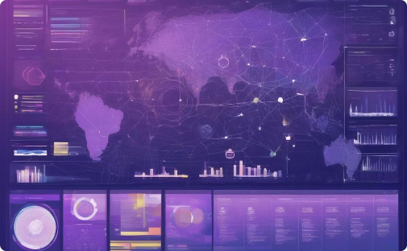
Transforming Urban Response with B.A.P.U
BAPU: Behavioural Analysis & Prediction Unit
Predictive Location Modeling
Innovative Approach
Combining predictive analytics and IoT to drive sustainable urban solutions.
Leveraging insights to enable proactive traffic and emergency management, improving safety and efficiency.
Forecasting and discovering behavioural patterns to optimize mobility.

Slide 3

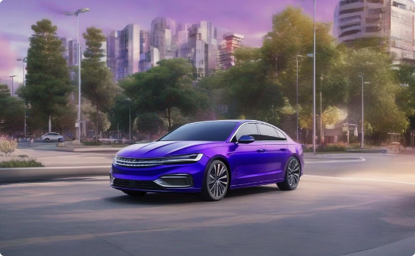
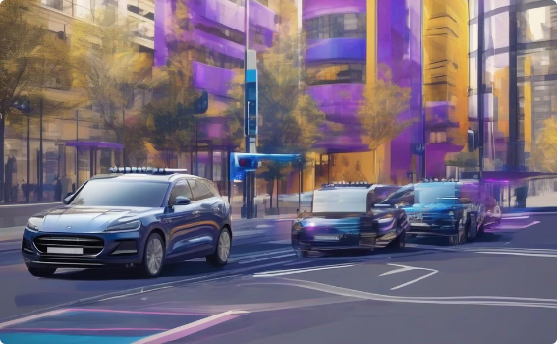
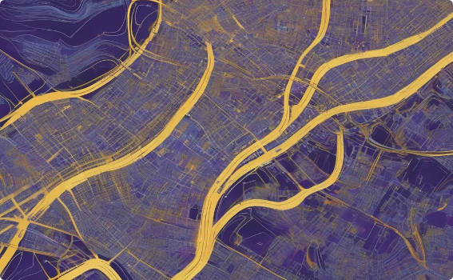
Data Source
ANPR systems capture license plate info, timestamps, and locations as vehicles pass.
Comprehensive Coverage
Integrating data from multiple ANPR cameras provides a city-wide view of vehicle movements.
Rich Insights
ANPR data offers potential for understanding complex vehicle movement patterns.

Slide 4

Analyzing Driving Patterns
1
Identify Normal Behavior
Establish baseline for regular driving patterns, routes, and timings.
2
Detect Outliers
Spot unusual or suspicious activity deviating from established norms.
3
Gain Behavioral Insights
Reveal underlying behaviors like evasion attempts or routes used for illicit activities.

Slide 5
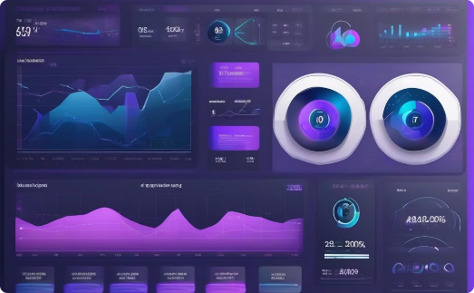


Advanced Outlier Detection
Statistical Analysis
Machine Learning
Enhanced Predictive Capability
Apply statistical methods to identify outliers in driving patterns.
Train ML models to detect outliers accurately and in real-time.
Improve ability to identify vehicles of interest or unusual driving behavior.

Slide 6




Adrenaline Impact on Driving
Behavioral Influence
Adrenaline significantly impacts driving, often leading to erratic or high-speed behavior.
Pattern Recognition
Identify patterns associated with adrenaline-influenced driving.
Predictive Modeling
Incorporate adrenaline-related behaviors to improve prediction accuracy in high-stress scenarios.

Slide 7
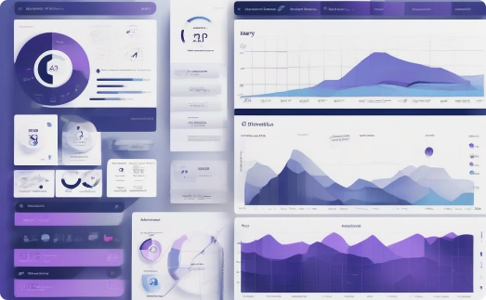
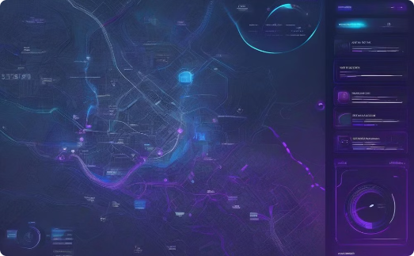
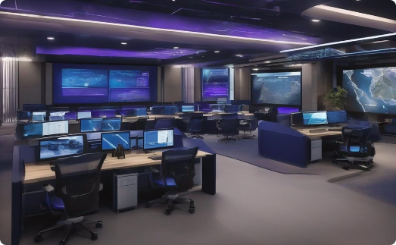
Predictive Location Modeling
Historical Data Analysis
Real-Time Prediction
Proactive Resource Management
Leverage past ANPR data to understand typical vehicle routes and behaviors, enabling more effective law enforcement strategies.
Harness current driving patterns to forecast future vehicle movements, allowing proactive resource allocation and interception.
Utilize predictive insights to strategically position law enforcement assets, improving the efficiency and effectiveness of interdiction efforts.

Slide 8
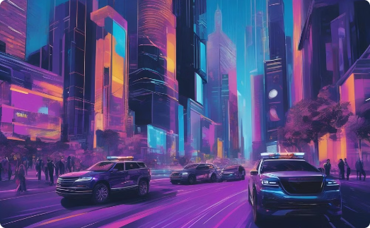
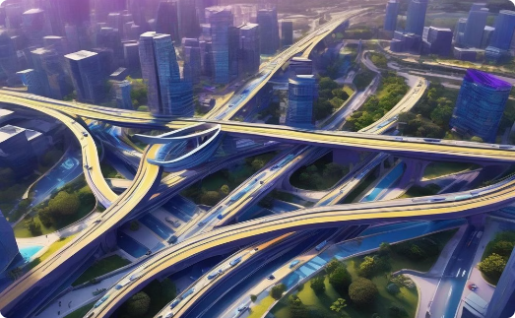
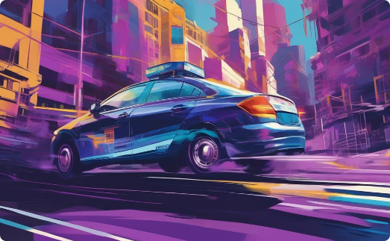
Applications
Law Enforcement
Traffic Management
Public Safety
Track and predict movements of vehicles involved in criminal activities.
Identify congestion patterns and optimize traffic flow in urban areas.
Enhance road safety by predicting and responding to high-risk driving behaviors.

Slide 9
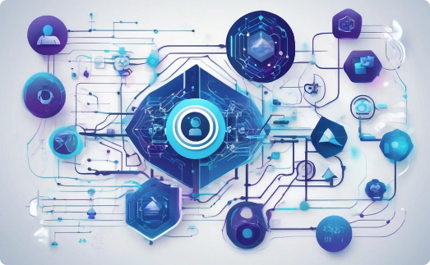
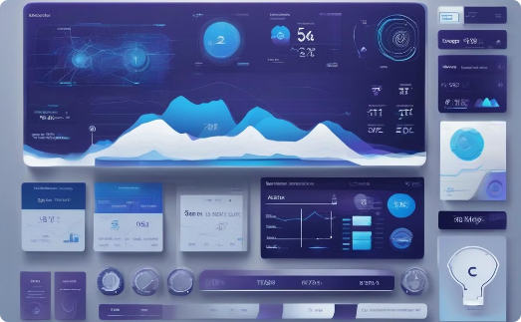

Behavioral Science Integration
Real-Time Analytics
Scalability
Providing up-to-the-minute predictions to enable effective, responsive law enforcement operations.
Designed for seamless expansion across regions and integration with other data sources.
Combining advanced behavioral insights with cutting-edge machine learning techniques.

